Slide 1
Handling uncertainty with fuzzy systems
Lkhagva-Ochir, 202339663

Slide 2
Contents
•Introduction
•Classical sets
•Fuzzy sets
•Fuzzy logic
•Membership function
•Real-life applications
•Conclusion

Slide 3
What is a fuzzy system?
Fuzzy systems allow us to handle uncertainty and make decisions more like humans do.
“Is it hot today?” - The answer is not “Yes or No”
Vague groups of things such as “short men”, “warm days”, etc

Slide 4
Classical sets
A classical set is a container that includes or excludes any given element. Any element X must be either in set A or in set not-A. It cannot be in both. And these two sets, set A and set not-A, should contain the entire universe between them.

Slide 5
Pen
Animals
Monday
Tuesday
Friday
Wednesday
Dog
Bag

Slide 6
Fuzzy sets
A fuzzy set allows elements to have degrees of membership, ranging from 0 to 1.
It does not restrict themselves in set A or in set not-A.
170 cm → 0.4 tall
180 cm → 0.7 tall
190 cm → 0.9 tall
This means a person can partially belong to the “tall” category.
Fuzzy sets are defined using something called a membership function, which shows how each input maps to a value between 0 and 1.

Slide 7
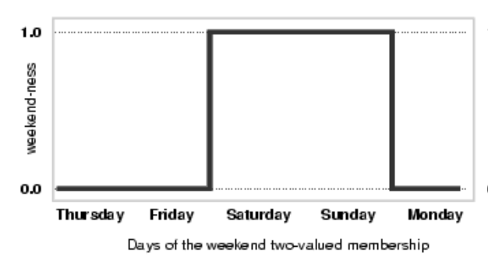
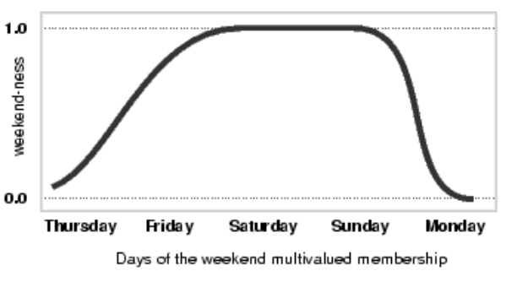

Slide 8
Fuzzy logic
Fuzzy logic is a superset of conventional (Boolean) logic that has been extended to handle the concept of partial truth—truth values between
Completely true
Completely true

Slide 9
Membership function
It can be any function ranging from a simple linear straight line to a complicated spline function or a polynomial of a higher degree. Some characteristics of the membership functions are:
• It is represented by the Greek symbol “µ”
• Truth values range between 0.0 and 1.0
0.0 = false
1.0 = true

Slide 10


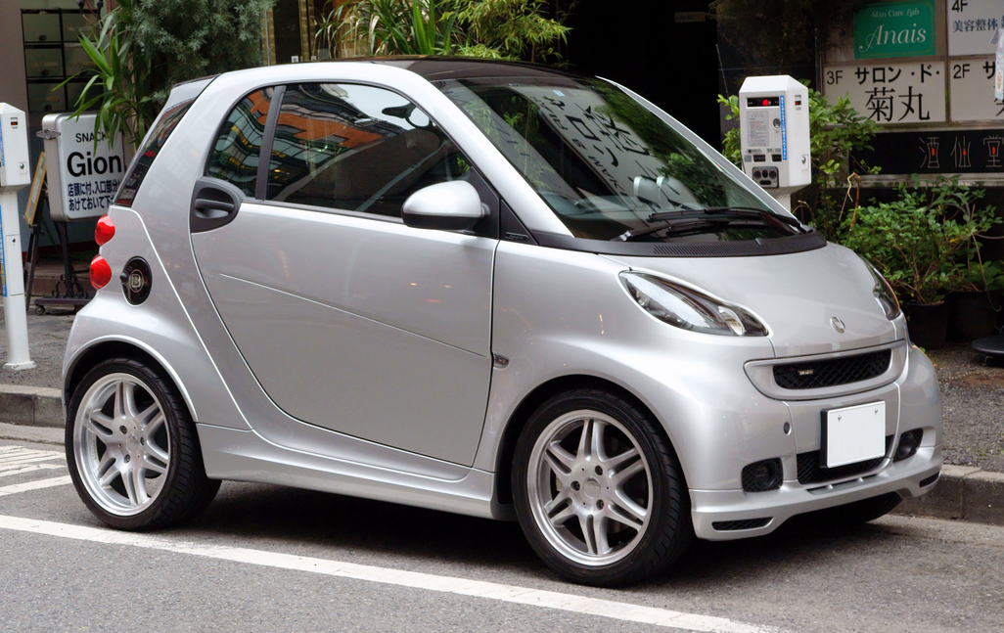
Real-life application

Slide 11
Conclusion
Classical sets use strict yes-or-no membership.
Fuzzy sets allow partial membership.
Membership functions define how inputs map to those degrees.
Fuzzy logic uses these ideas for reasoning.

